Slide 1
Open Source Platform and Network Administration
Lesson 22

Slide 3
Common Package Managers
Yellowdog Updater, Modified (YUM)
Advanced Package Tool (APT)
Portage and emerge
Zypper
Conary
Notes:
Common Packaging Methods:
RPM Package Manager (Formerly Red Hat Package Manager)
Debian package
Gentoo Linux is a popular distribution that downloads and compiles from source code. It does not use packaged software.

Slide 4
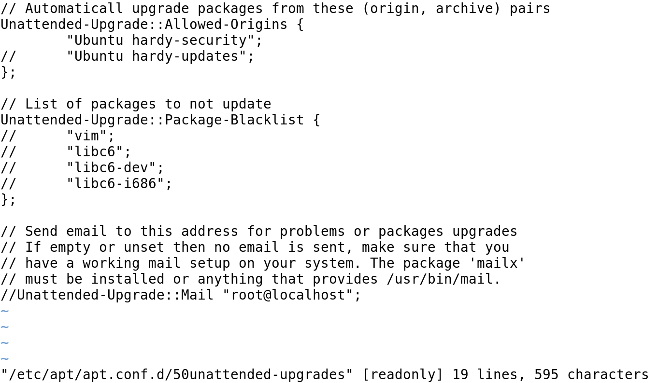
Ubuntu 50unattended-upgrades Configuration File

Slide 5
Graphical Package Managers
PackageKit
Synaptic
Porthole
YaST (Yet another Setup Tool)

Slide 6
Best Practices for Compiling Software
You must know about the software you are downloading. Make sure that it is from a reputable organization.
Verify the source code.
Do not compile the software as root if it can be compiled as a regular user.
Always read the README file.
Follow recommendations of the Linux Filesystem Hierarchy Standard (FHS).

Slide 7
Commercial Linux Vendor
Monitors specific software vulnerabilities
Provides patches to the software
Packages the software
Tests the patches
Notifies customers and provides updates

Slide 8
Open Source Update Managers
Key Tools
apt-* Command
RedHat
RedHat Spacewalk
yum Command

Slide 9
Summary
Common and graphical package managers
Red Hat Satellite Server
Processes to apply security updates
Importance of anti-virus software in Linux security
Software management plans

Slide 10
Virtual Lab
Applying Best Practices for Secure Software Management
Notes:
If your educational institution included the Jones & Bartlett labs as part of the course curriculum, use this script to introduce the lab:
"In this lesson, you found that the best practices for handling security updates include first verify the source of the update before installing it to your system. A company may choose automated update tools, in the case of a trusted developer, or create a local update repository which allows you time to test updates before they get installed. Regardless of the update option used by the organization, it is always best practice to limit the number of applications installed on the system.
In this lab, you will work with a CentOS machine and use RPM to query and verify package files, verify a source tarball used for application integrity verification when downloading and installing new applications, and learn how to create a repository to properly secure the RPN databases. You will also use the md5sum for hashing and integrity verification against downloaded program files. Finally, you will learn to use GPG (GnuPG) tool to view a GPG license key to ensure downloaded software is valid.”

